Slide 1
Apple Stock Price Forecasting
Presentation
Mentor :Sravani
TEAM MEMBERS:
1.Mitali Dinesh Aswale
2.Niharika Gedela
3.Aashritha Molleti
4.Akriti Chhaya
5.Aditya Hase

Slide 2
Objective
Build and launch a predictive model to forecast Apple Inc.’s stock prices over the next 30 days, using historical data from 2012 to 2019. This project aims to empower investors and analysts with:
Accurate trend insights
Robust model evaluation
Interactive, web-based visualization tools for smarter, data-driven decision-making.

Slide 3
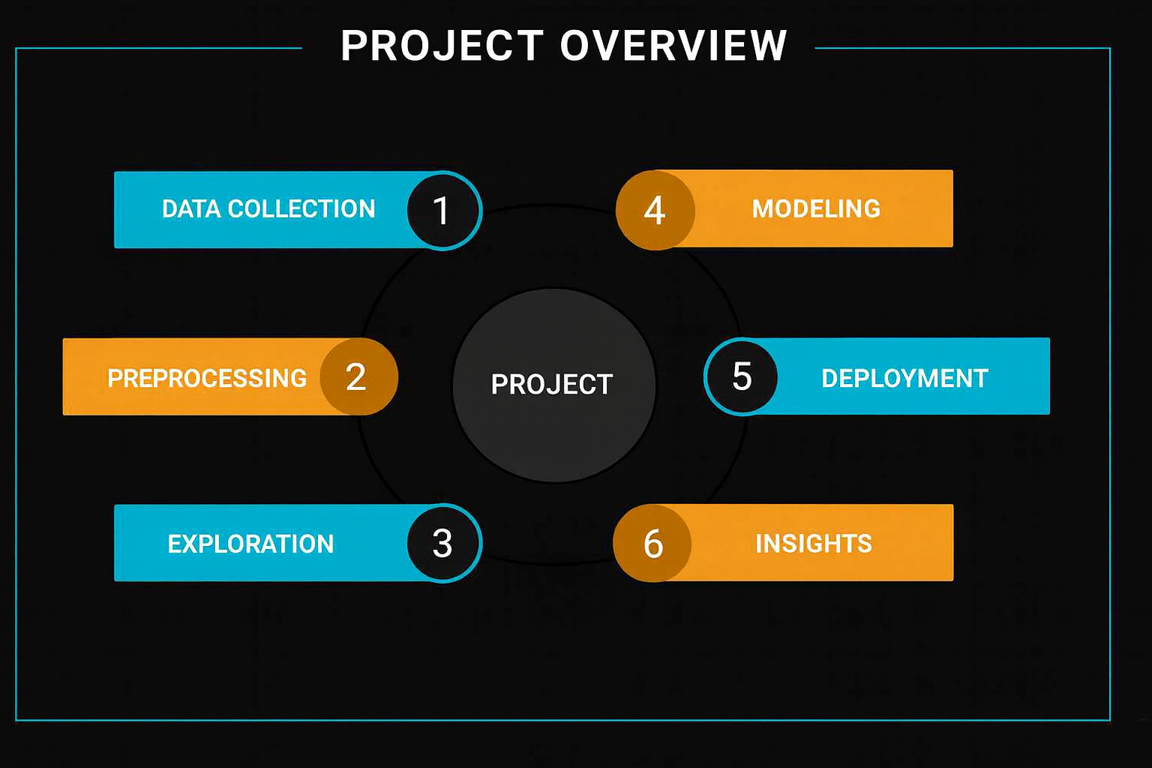

Slide 4
📊 Dataset Overview
Source: Historical stock data of Apple Inc. from 2012 to 2019.
Frequency: Daily trading data.
Records: Over 2,000 entries (one for each trading day).
🔍 Attributes :
Date: Trading date
Open: Opening price of Apple stock
High: Highest price of the day
Low: Lowest price of the day
Close: Closing price of the day (Target variable)
Volume: Number of shares traded

Slide 5
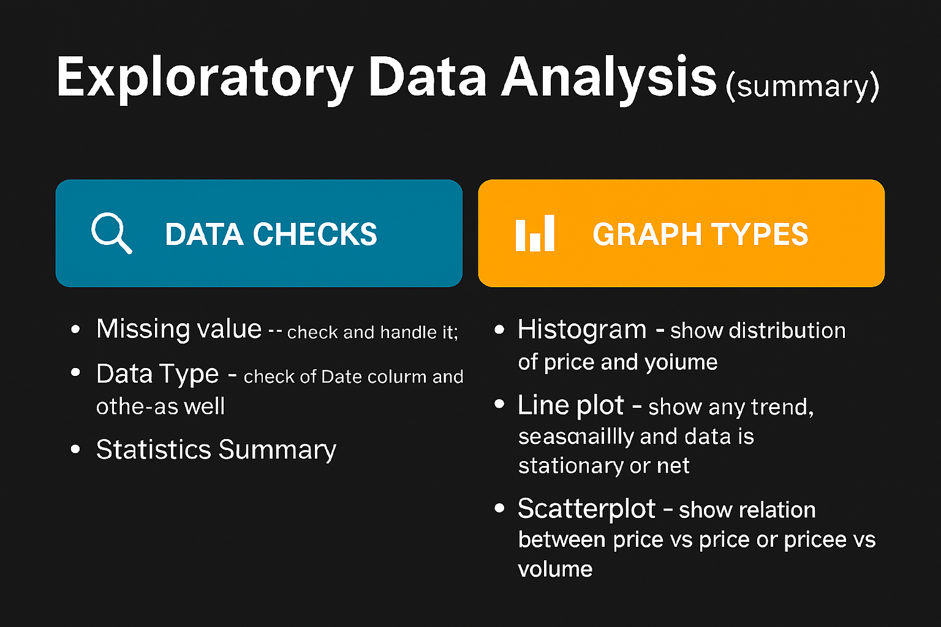

Slide 6
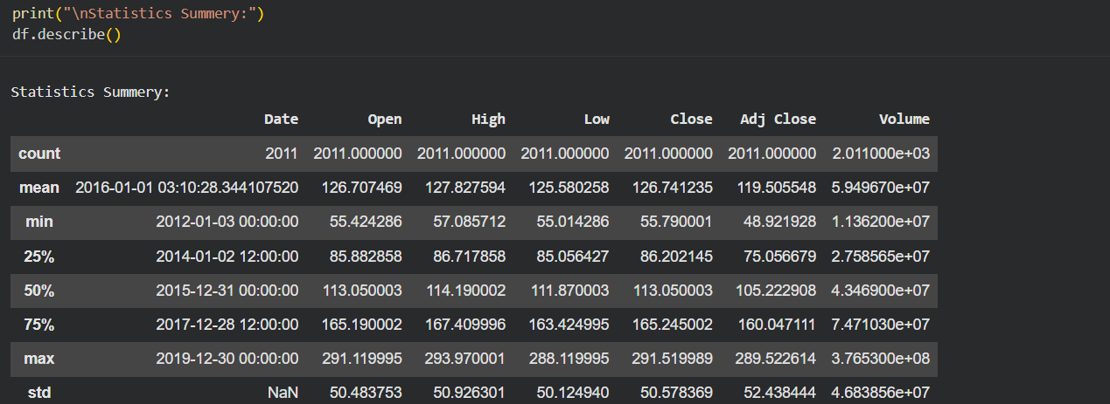
📈 Statistical Summary

Slide 7
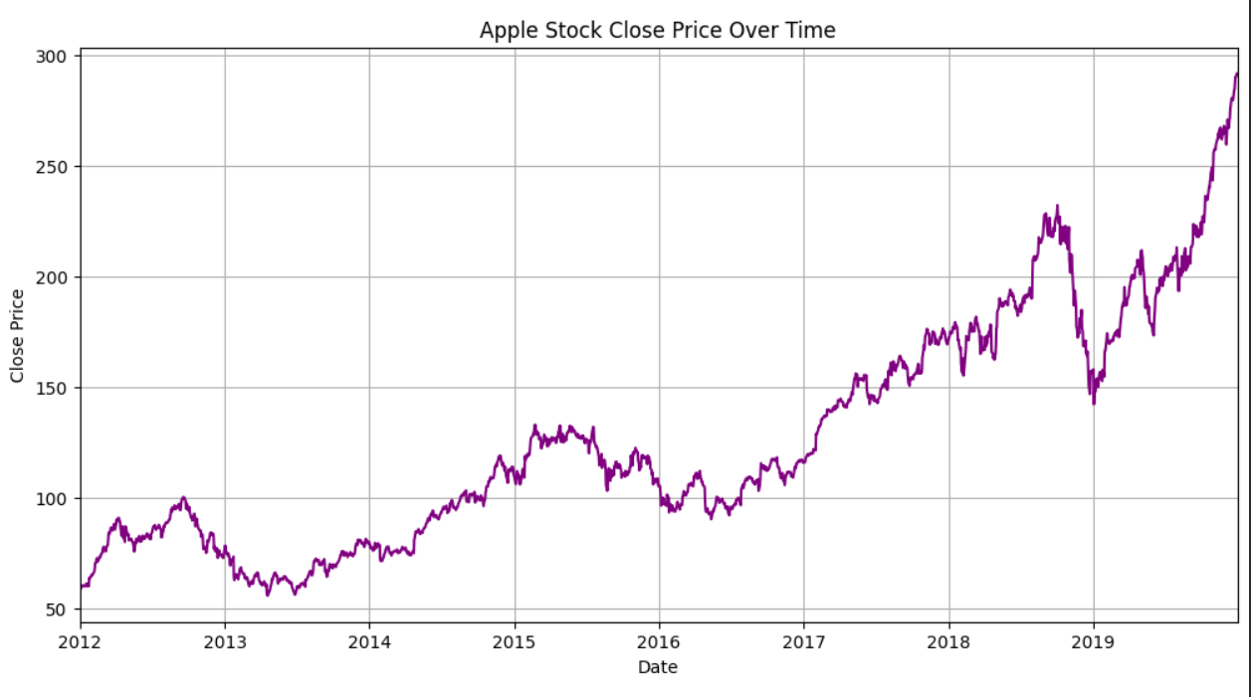
Line plot of Close price

Slide 8
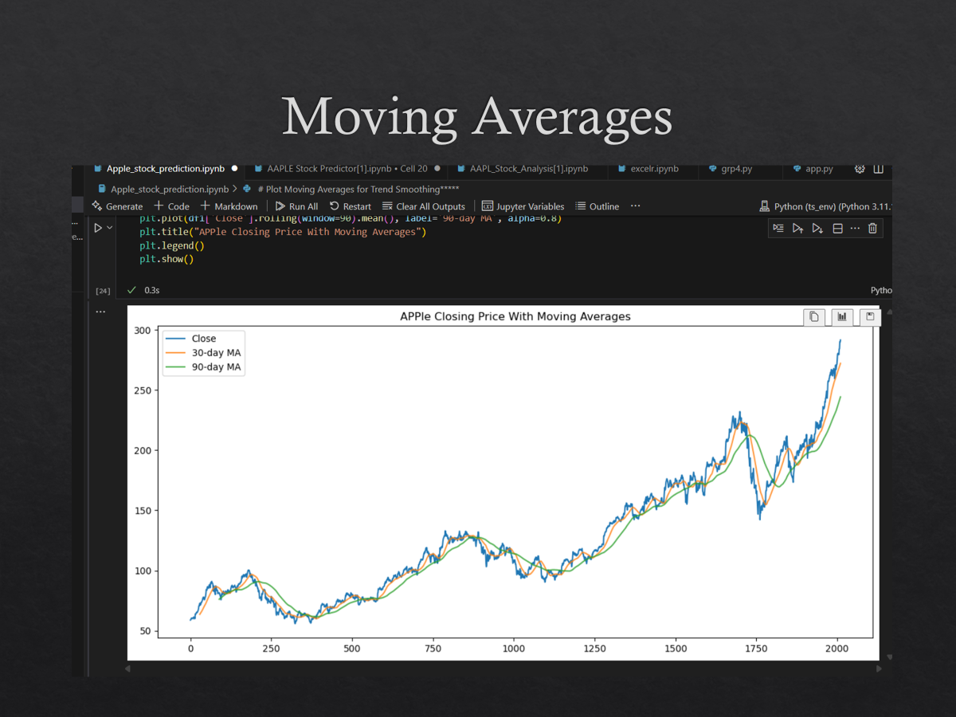
Moving Averages for 30 days

Slide 9
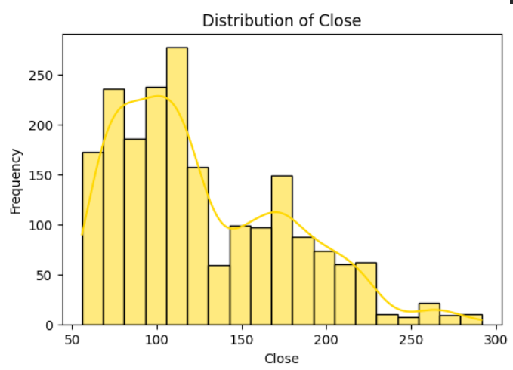
Histogram of close price

Slide 10
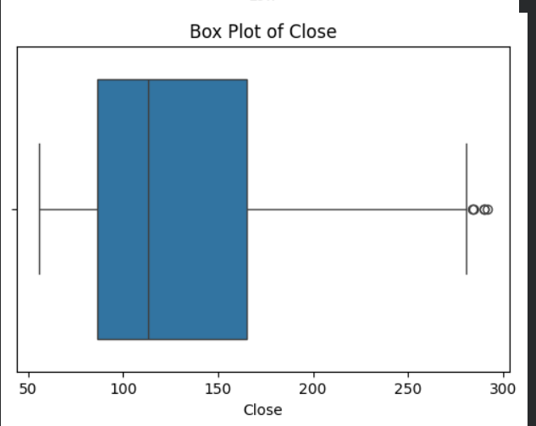
Box plot of close price

Slide 11
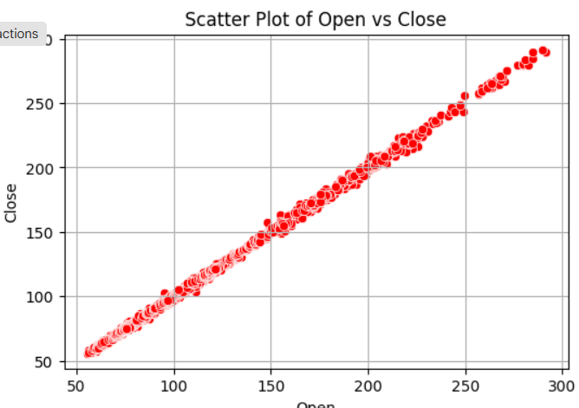
Scatter plot price vs price

Slide 12
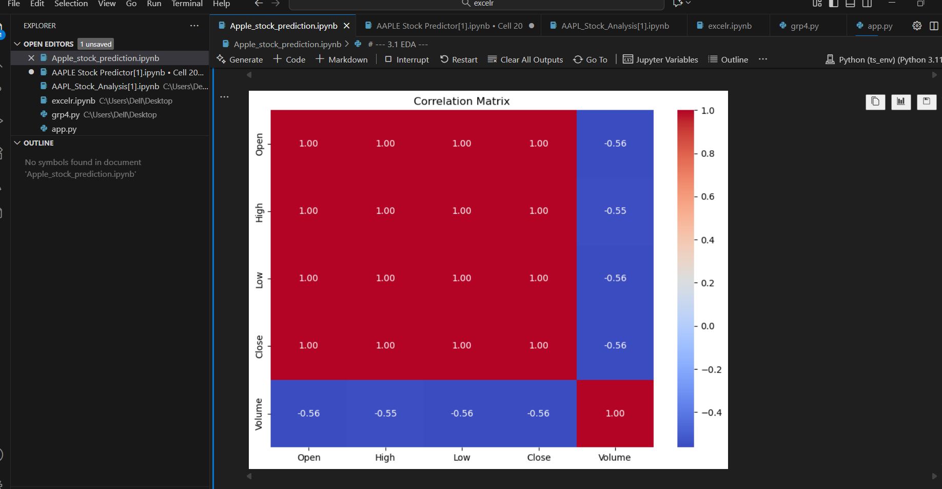
Correlation Heatmap

Slide 13
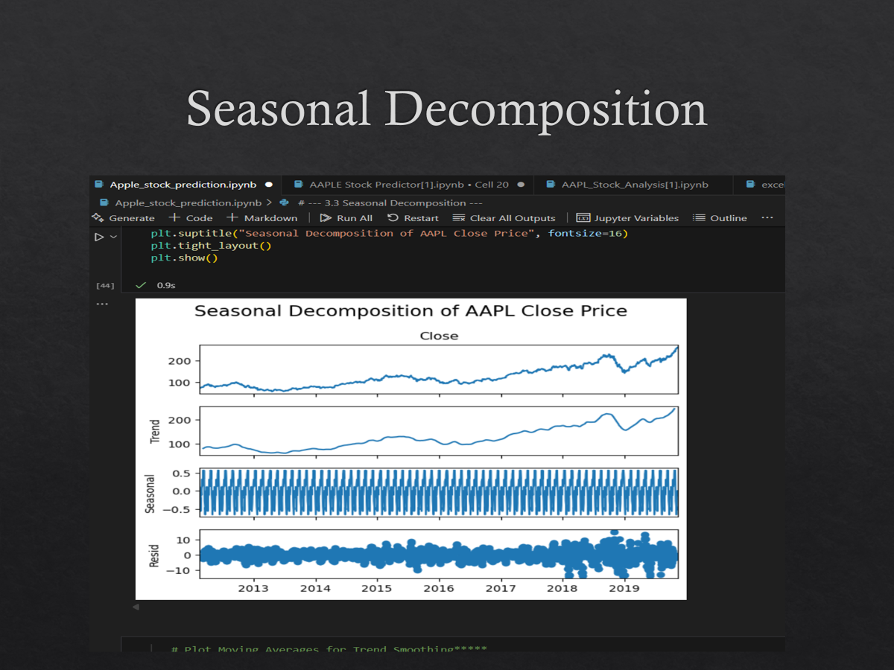
Seasonal Decomposition

Slide 14
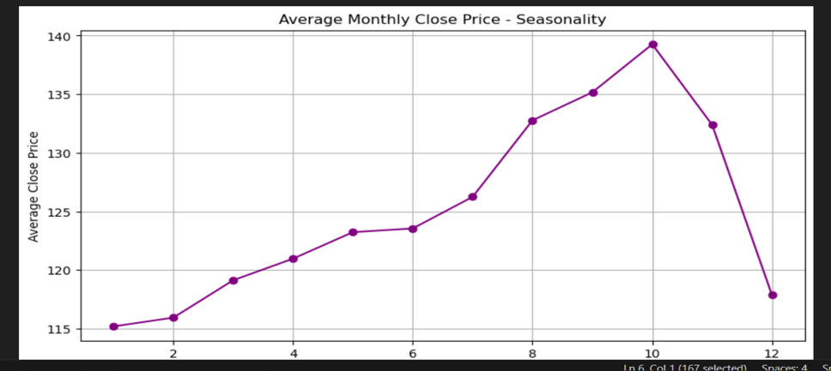
Monthly Seasonality

Slide 15
🛠️ Model Building
Models Used:
ARIMA and SARIMA for time series forecasting
XGBoost and Random Forest for supervised learning and ensemble-based predictions
Feature Engineering:
Moving Average: captures trend and smoothing
Volatility: measures variability and risk in time series data
Hyperparameters:
ARIMA/SARIMA: p, d, q, seasonal order
XGBoost/RF: n_estimators, learning_rate, max_depth
Evaluation Metrics:
RMSE: Root Mean Squared Error
MSE: Mean Squared Error
⌛ Summary - Combines statistical and machine learning models to forecast and analyze time series data effectively.

Slide 16
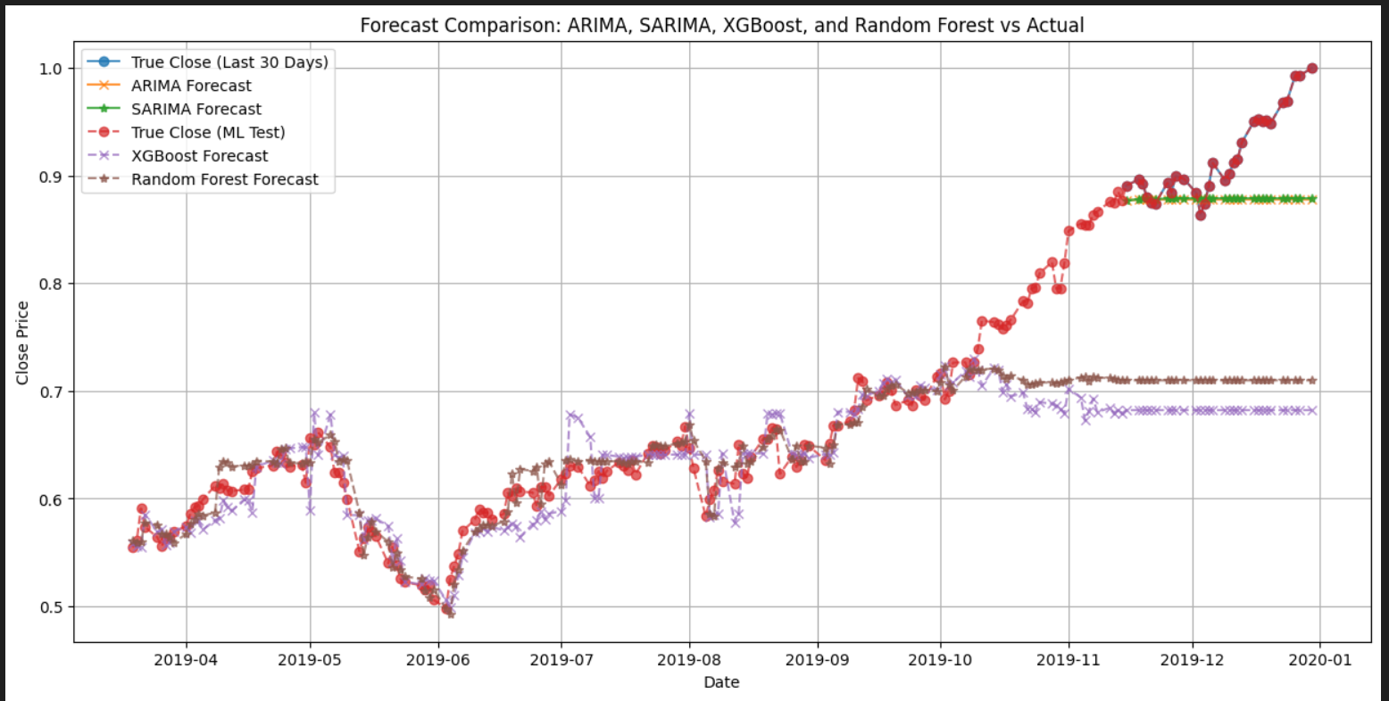
Arima, Sarima , Xgboost and Random forest model Comparison line plot

Slide 17
🖥️ Model Deployment Overview
Platform: Deployed using Streamlit, offering an interactive and user-friendly interface for real-time stock price prediction.
Final Model: SARIMA selected for deployment due to its strong performance in capturing seasonality and trends in time series data.
Added Value:
Streamlit dashboard allows dynamic input (e.g., stock ticker, date range)
Results update instantly, making it ideal for financial forecasting and strategy

Slide 18
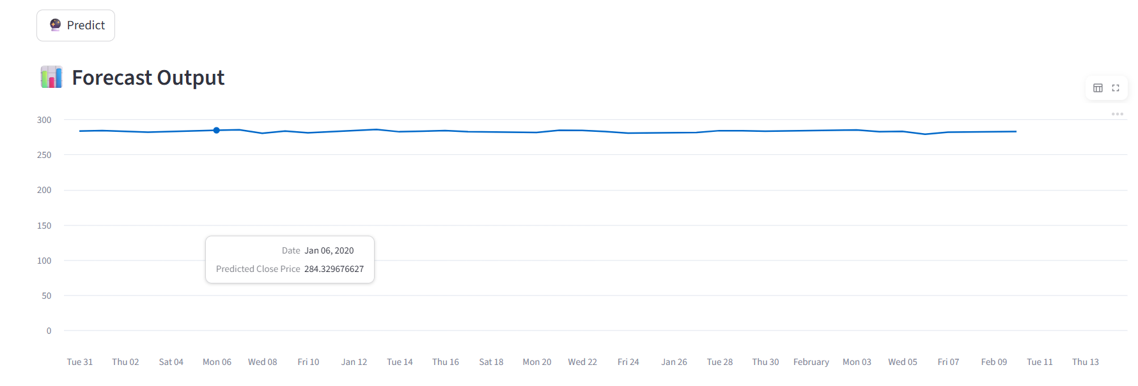
Forecast variation for next 30 days

Slide 19
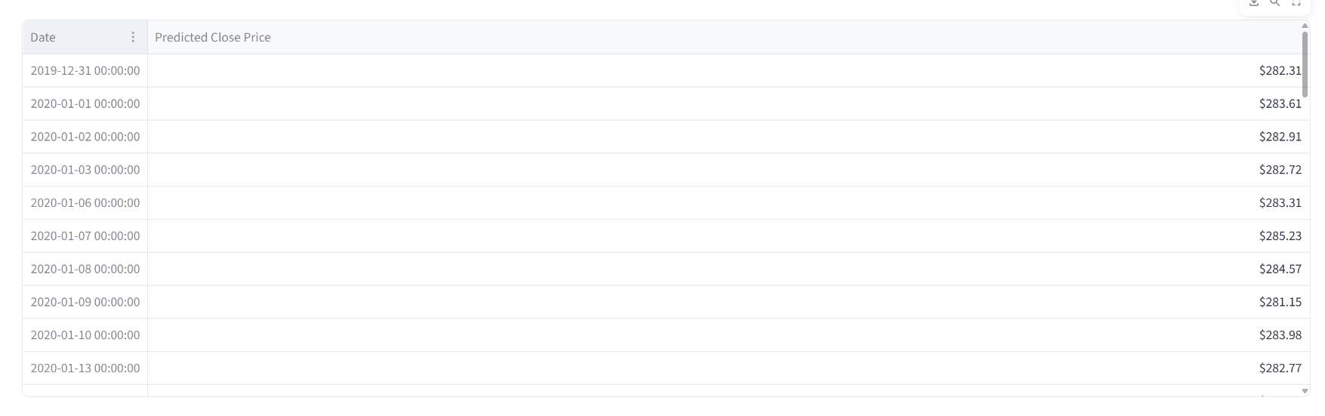
Forecast Predicted price next 30 days

Slide 20
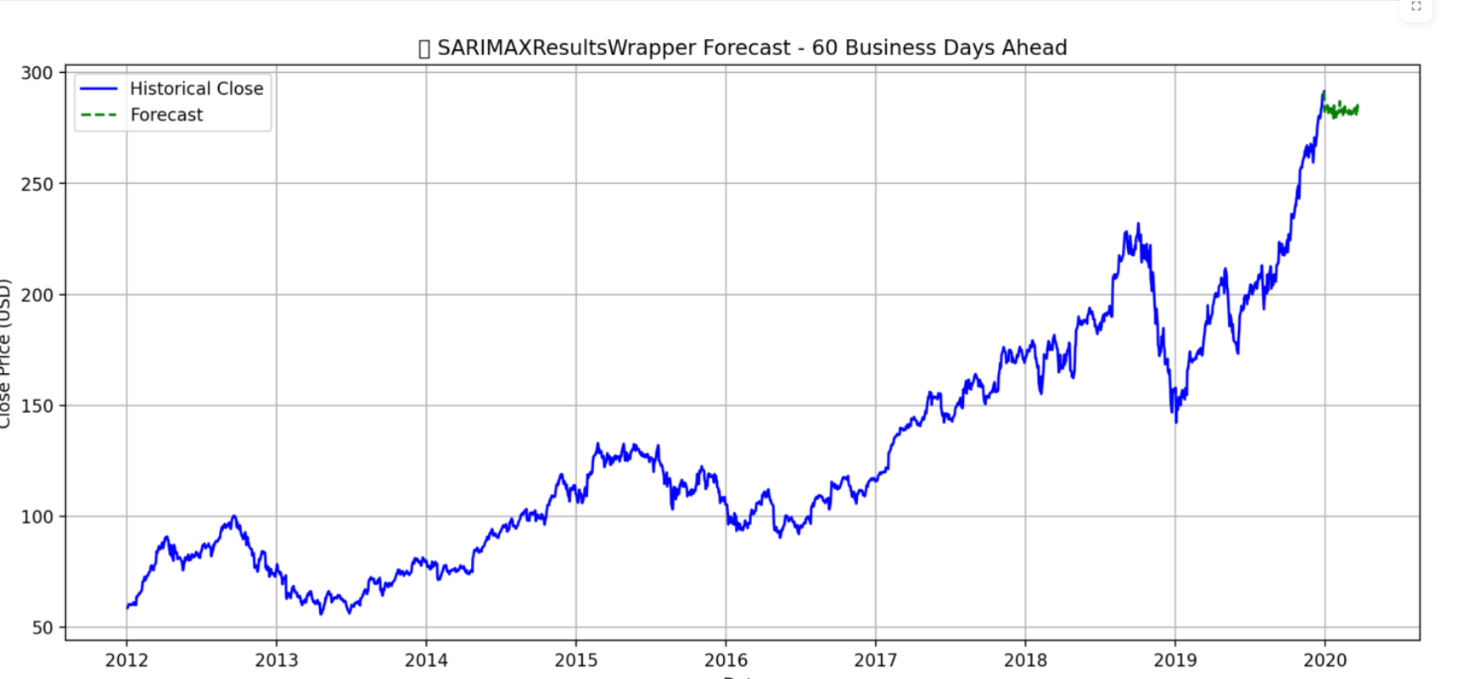
Forecast 60 Days Ahead

Slide 21
✅ conclusion
>Successfully developed and deployed a predictive model to forecast Apple Inc.’s stock prices for the next 30 days.
>Conducted comprehensive EDA to identify trends, seasonality, and volatility in stock movement.
>Implemented and compared ARIMA, SARIMA, XGBoost, and Random Forest models for forecasting accuracy.
>Selected SARIMA as the final model due to its superior performance in capturing seasonality.
>Created an interactive Streamlite web app, enabling real-time predictions and visualization.
>Provides a data-driven decision-support tool for investors, traders, and analysts.

Slide 22
🚀 Future Scope
>Enhance the Streamlit dashboard with interactive analytics, visual comparisons, and model selection options.
>Allow users to compare multiple stocks at the same time.
>Add a notification or alert system for sudden trend changes..
>Deploy on a cloud platform (like AWS or Azure) for faster performance and wider access.

Slide 23


